Slide 1
Anonymous Walk Embeddings
Muntean Norbert-Cristian
AC CTI-RO, an 3, grupa 5.2

Slide 2
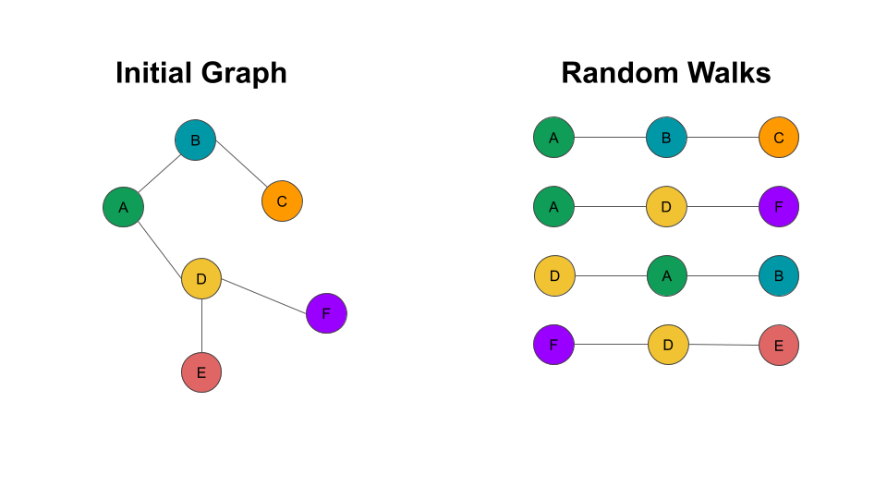
Random Walk
Sequences of nodes
Each node is selected
independently

Slide 3
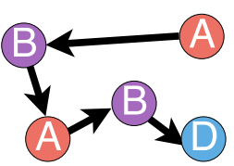

Positional function
S = (a, b, a, b, d)
Pos(s, a) = (1,3)
Pos(s, b) = (2,4)
Pos(s, d) = (5)

Slide 4
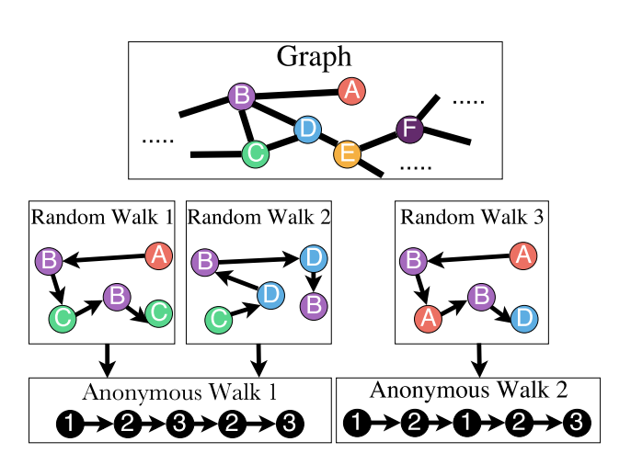
Anonymous Walk

Slide 5
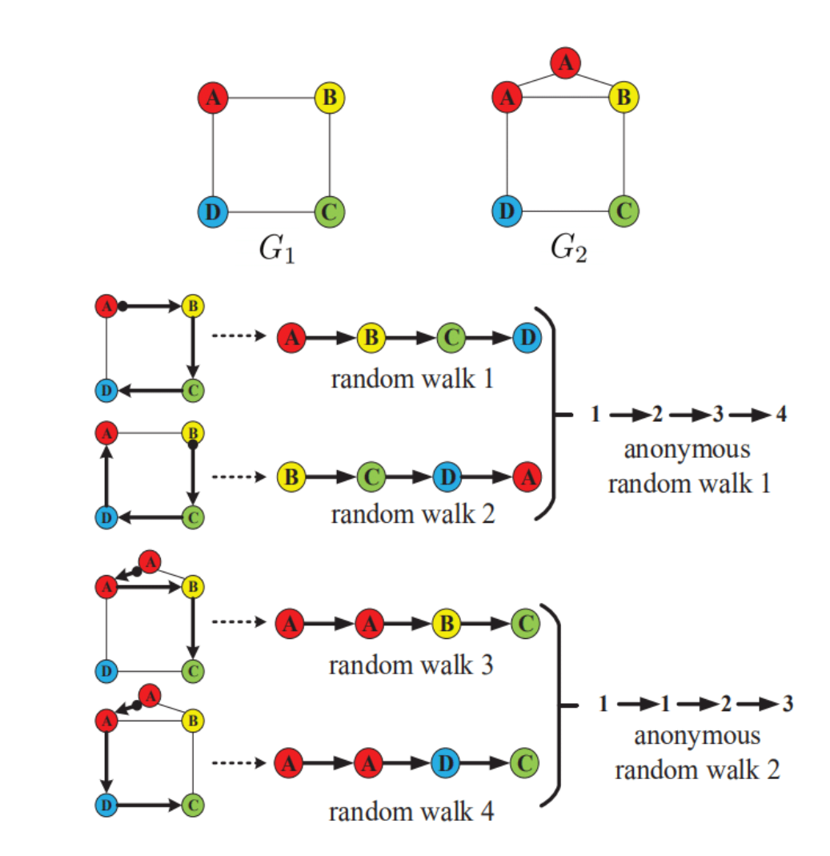
Anonymous Walk

Slide 6
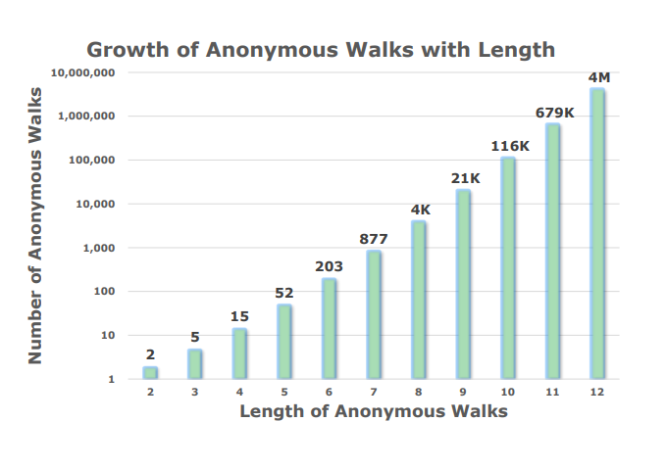
Anonymous Walk

Slide 7
Probability of Anonymous Walk
A = (a1, a2, …,aη ) – all possible Anonymous Walks of length l
fG = (p(a1), p(a2), …,p(aη) ) – the probability of having the Anonymous Walk ai in the Graph G

Slide 8

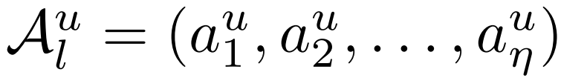
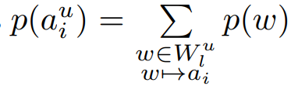
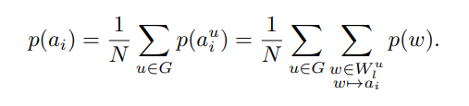
Probability of Anonymous Walk

Slide 9
Mutag Dataset
A collection of nitro aromatic compounds
The vertices stand for atoms and are labeled by the atom type
The edges between vertices represent bonds between the corresponding atoms
It includes 188 samples of chemical compounds with 7 discrete node labels

Slide 10
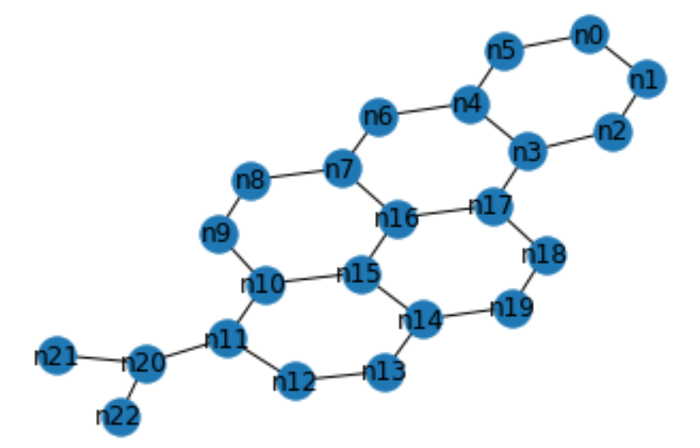
Graph from the Mutag Dataset

Slide 11
Bibliography
https://arxiv.org/abs/1805.11921
https://arxiv.org/pdf/1805.11921.pdf
https://www.youtube.com/watch?v=VVml3nDiM3E
https://github.com/nd7141/AWE

